Slide 1

Ecology and Comparative Analysis of the Gut Microbiome of Pancreatic Cancer Patients
BIO 5202
Okpe, Uchenna
5/6/25

Slide 2
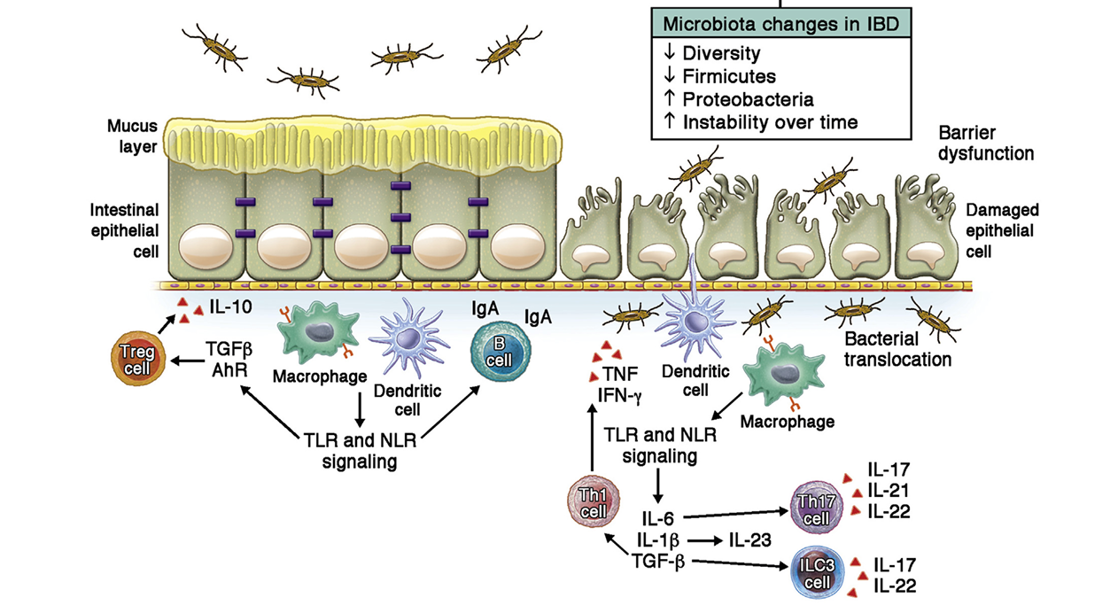
Gut microbiome
Genetic Risk Factors
Environmental Factors
Microbial factors

Slide 3
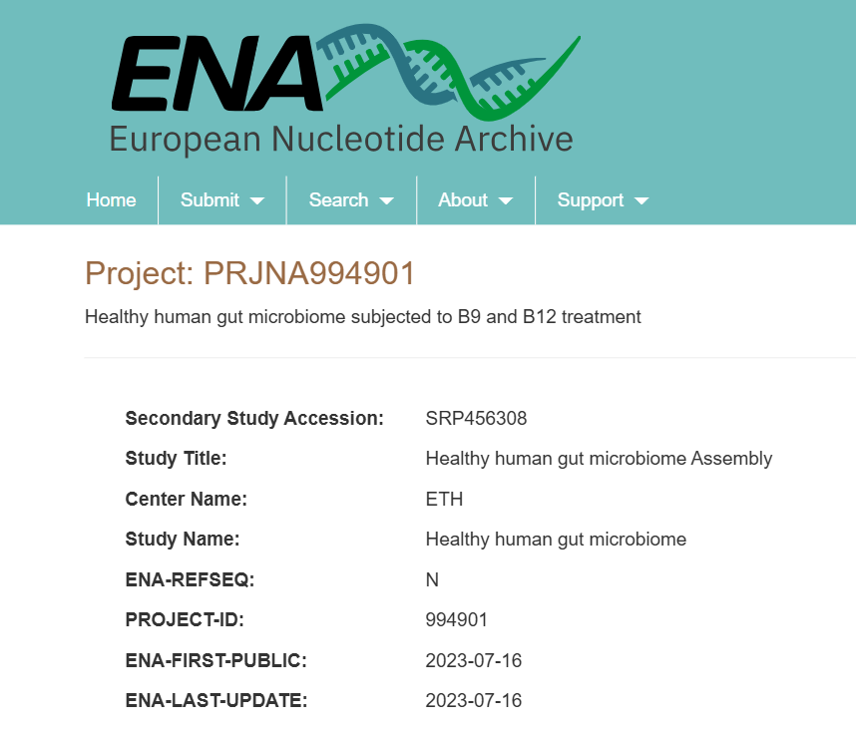
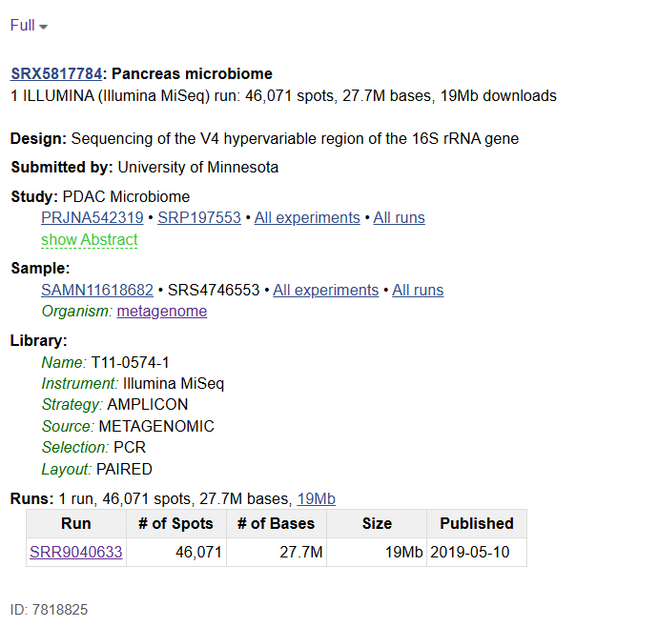
Objectives
Is there a difference in the gut microbiome of a healthy and cancer patients?
What microbes are mostly associated with healthy vs cancer patients?

Slide 4
Methodology
Quality control
Clustering
Chimera removal
Taxonomic Classification
Feature table construction
Relative abundance calculation
Comparative taxonomic analysis
Notes:
Beta-glucosidase → break down flavonoid glycosides

Slide 5
Comparative Gut microbial abundance in healthy and pancreatic cancer patients
# Load libraries
library(readr)
library(dplyr)
library(tidyr)
library(ggplot2)
library(viridis)
# Step 1: Read data (phylum in rows, samples in columns)
hh_url <- "https://raw.githubusercontent.com/okpecallistus/Uchenna5202stuff/refs/heads/main/HH_combined_bracken_phylum_fraction.csv"
pc_url <- "https://raw.githubusercontent.com/okpecallistus/Uchenna5202stuff/refs/heads/main/PC_combined_bracken_phylum_fraction.csv"
hh_phylum <- read.csv(hh_url, row.names = 1, check.names = FALSE)
pC_phylum <- read.csv(pc_url, row.names = 1, check.names = FALSE)
# Step 2: Transpose and reshape to long format
hh_long <- hh_phylum %>%
t() %>%
as.data.frame() %>%
mutate(Sample = rownames(.), Group = "Healthy") %>%
pivot_longer(-c(Sample, Group), names_to = "Phylum", values_to = "Abundance")
pc_long <- pC_phylum %>%
t() %>%
as.data.frame() %>%
mutate(Sample = rownames(.), Group = "Cancer") %>%
pivot_longer(-c(Sample, Group), names_to = "Phylum", values_to = "Abundance")
# Step 3: Combine datasets
long_data <- bind_rows(hh_long, pc_long)
# Step 3: Combine datasets
long_data <- bind_rows(hh_long, pc_long)
group_by(Sample) %>%
mutate(Abundance = Abundance / sum(Abundance, na.rm = TRUE)) %>%
ungroup()
bar_plot<-ggplot(long_data_norm, aes(x = Sample, y = Abundance, fill = Phylum)) +
geom_bar(stat = "identity") +
facet_wrap(~ Group, scales = "free_x") +
theme_minimal(base_size = 12) +
labs(title = "Gut Microbiome Composition at Phylum Level",
y = "Relative Abundance", x = "Sample") +
theme(axis.text.x = element_blank(), axis.ticks.x = element_blank()) +
scale_fill_viridis_d(option = "D")
print(bar_plot)
ggsave("phylum_barplot.png", bar_plot, width = 10, height = 6, dpi = 300)

Slide 6
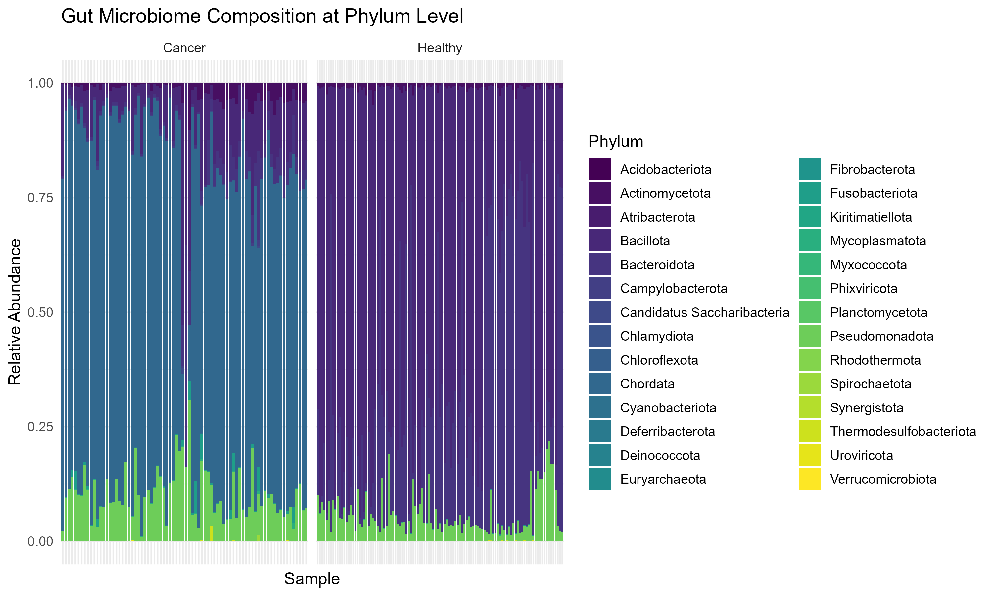
Comparative Gut microbiome abundance I healthy and pancreatic cancer patients
Fig.1: Comparative abundance of the gut microbiome of healthy VS Cancer patients

Slide 7
Ecological properties of the Gut microbiome in Healthy and Cancer patients(α-diversity)
#install.packages(c("readxl", "vegan", "ggplot2", "dplyr", "ggpubr"))
library(readxl)
library(vegan)
library(ggplot2)
library(dplyr)
library(ggpubr)
view(diversity_df)
view(pC_diversity_df)D
#Read my data and assign them names
hh_species<- (Healthy individuals)
pC_species<- (cancer patients)
#Transpose data
pC_species_t<-t(pC_species)
hh_species_t<-t(hh_species)
#Compute Diversity Indices
library(vegan)
pC_shannon_index_sp<-diversity(pC_species_t_numeric, index = "shannon")
pC_simpson_index_sp<-diversity(pC_species_t_numeric, index = "simpson")
shannon_index_species<-diversity(hh_species_t_numeric,index = "shannon")
simpson_index_species<-diversity(hh_species_t_numeric, index = "simpson")
#Prepare Data for Plotting
pC_diversity_df<-data.frame(SampleID = rownames(pC_species_t_numeric),Shannon = pC_shannon_index_sp, Simpson = pC_simpson_index_sp)
view(pC_diversity_df)
diversity_df <- data.frame(
SampleID = rownames(hh_species_t_numeric),
Shannon = shannon_index_species,
Simpson = simpson_index_species)
#Convert data to numeric
Creat a new data frame, retaining column and row names
hh_species_t_numeric<-as.data.frame(hh_species_t)
#use lapply to convert each column to numeric while preserving names
hh_species_t_numeric<-hh_species_t_numeric%>%
mutate(across(everything(), ~as.numeric(.)))
Convert to numeric safely without losing names
#Create a new data frame, retaining column and row names
pC_species_t_numeric<-as.data.frame(pC_species_t)
view(pC_species_t_numeric)
#Use lapply to convert each column to numeric while preserving names
pC_species_t_numeric<-pC_species_t_numeric%>%
mutate(across(everything(),~as.numeric(.)))

Slide 8
Ecological properties of the Gut microbiome in Healthy and Cancer patients (α-diversity)
#Group Data
pC_diversity_df$Group<-"Cancer"
diversity_df$Group<-"Healthy"
#Combine Both Datasets
combined_div<-rbind(diversity_df, pC_diversity_df)
view(combined_div)
#Plot: Simpson BOXplot with Statistical Test
library(ggplot2)
library(ggpubr)
p_simpson <- ggplot(combined_div, aes(x = Group, y = Simpson, fill = Group)) +
geom_boxplot(width = 0.5, alpha = 0.9, outlier.shape = NA) +
geom_jitter(width = 0.15, alpha = 0.6, size = 1, color = "black") +
#Copute Shanono index:
p_shannon <- ggplot(combined_div, aes(x = Group, y = Shannon, fill = Group)) +
geom_boxplot(width = 0.5, alpha = 0.9, outlier.shape = NA) +
geom_jitter(width = 0.15, alpha = 0.6, size = 1, color = "black") +
# Statistical test with bar and asterisks
stat_compare_means(method = "wilcox.test", label = "p.signif",
comparisons = list(c("Healthy", "Cancer")), tip.length = 0.02, size = 5) +
# Apply a clean theme and add gridlines + border
theme_minimal(base_size = 12) + theme(panel.grid.major = element_line(color = "grey80"),panel.grid.minor = element_blank(), panel.border = element_rect(color = "black", fill = NA, size = 1),axis.text = element_text(size = 11), axis.title = element_text(size = 13),
legend.position = "none" ) +
labs( title = "Shannon Diversity: Healthy vs Cancer",
x = "Group", y = "Shannon Index") +
# Color-blind friendly & elegant colors (Okabe-Ito palette)
scale_fill_manual(values = c("Healthy" = "#56B4E9", "Cancer" = "#E69F00"))
print(p_shannon)
ggsave("combined_Simpson_Diversity_Boxplot.png", plot = p_shannon, width = 8, height = 6, dpi = 300)
# Wilcoxon rank-sum test (non-parametric)
wilcox.test(Shannon ~ Group, data = combined_div)
# Statistical test with bar and asterisks
stat_compare_means(method = "wilcox.test", label = "p.signif",
comparisons = list(c("Healthy", "Cancer")),
tip.length = 0.02, size = 5) +
# Apply a clean theme and add gridlines + border
theme_minimal(base_size = 12) +
theme( panel.grid.major = element_line(color = "grey80"),
panel.grid.minor = element_blank(),
panel.border = element_rect(color = "black", fill = NA, size = 1),
axis.text = element_text(size = 11), axis.title = element_text(size = 13), legend.position = "none") +
labs(title = "Simpson Diversity: Healthy vs Cancer", x = "Group",
y = "Simpson Index" ) +
# Color-blind friendly & elegant colors (Okabe-Ito palette)
scale_fill_manual(values = c("Healthy" = "#009E73", "Cancer" = "#D55E00"))
print(p_simpson)ggsave("combined_Simpson_Diversity_Boxplot.png", plot = p_simpson, width = 8, height = 6, dpi = 300)
# Wilcoxon rank-sum test (non-parametric)
wilcox.test(Simpson ~ Group, data = combined_div)

Slide 9
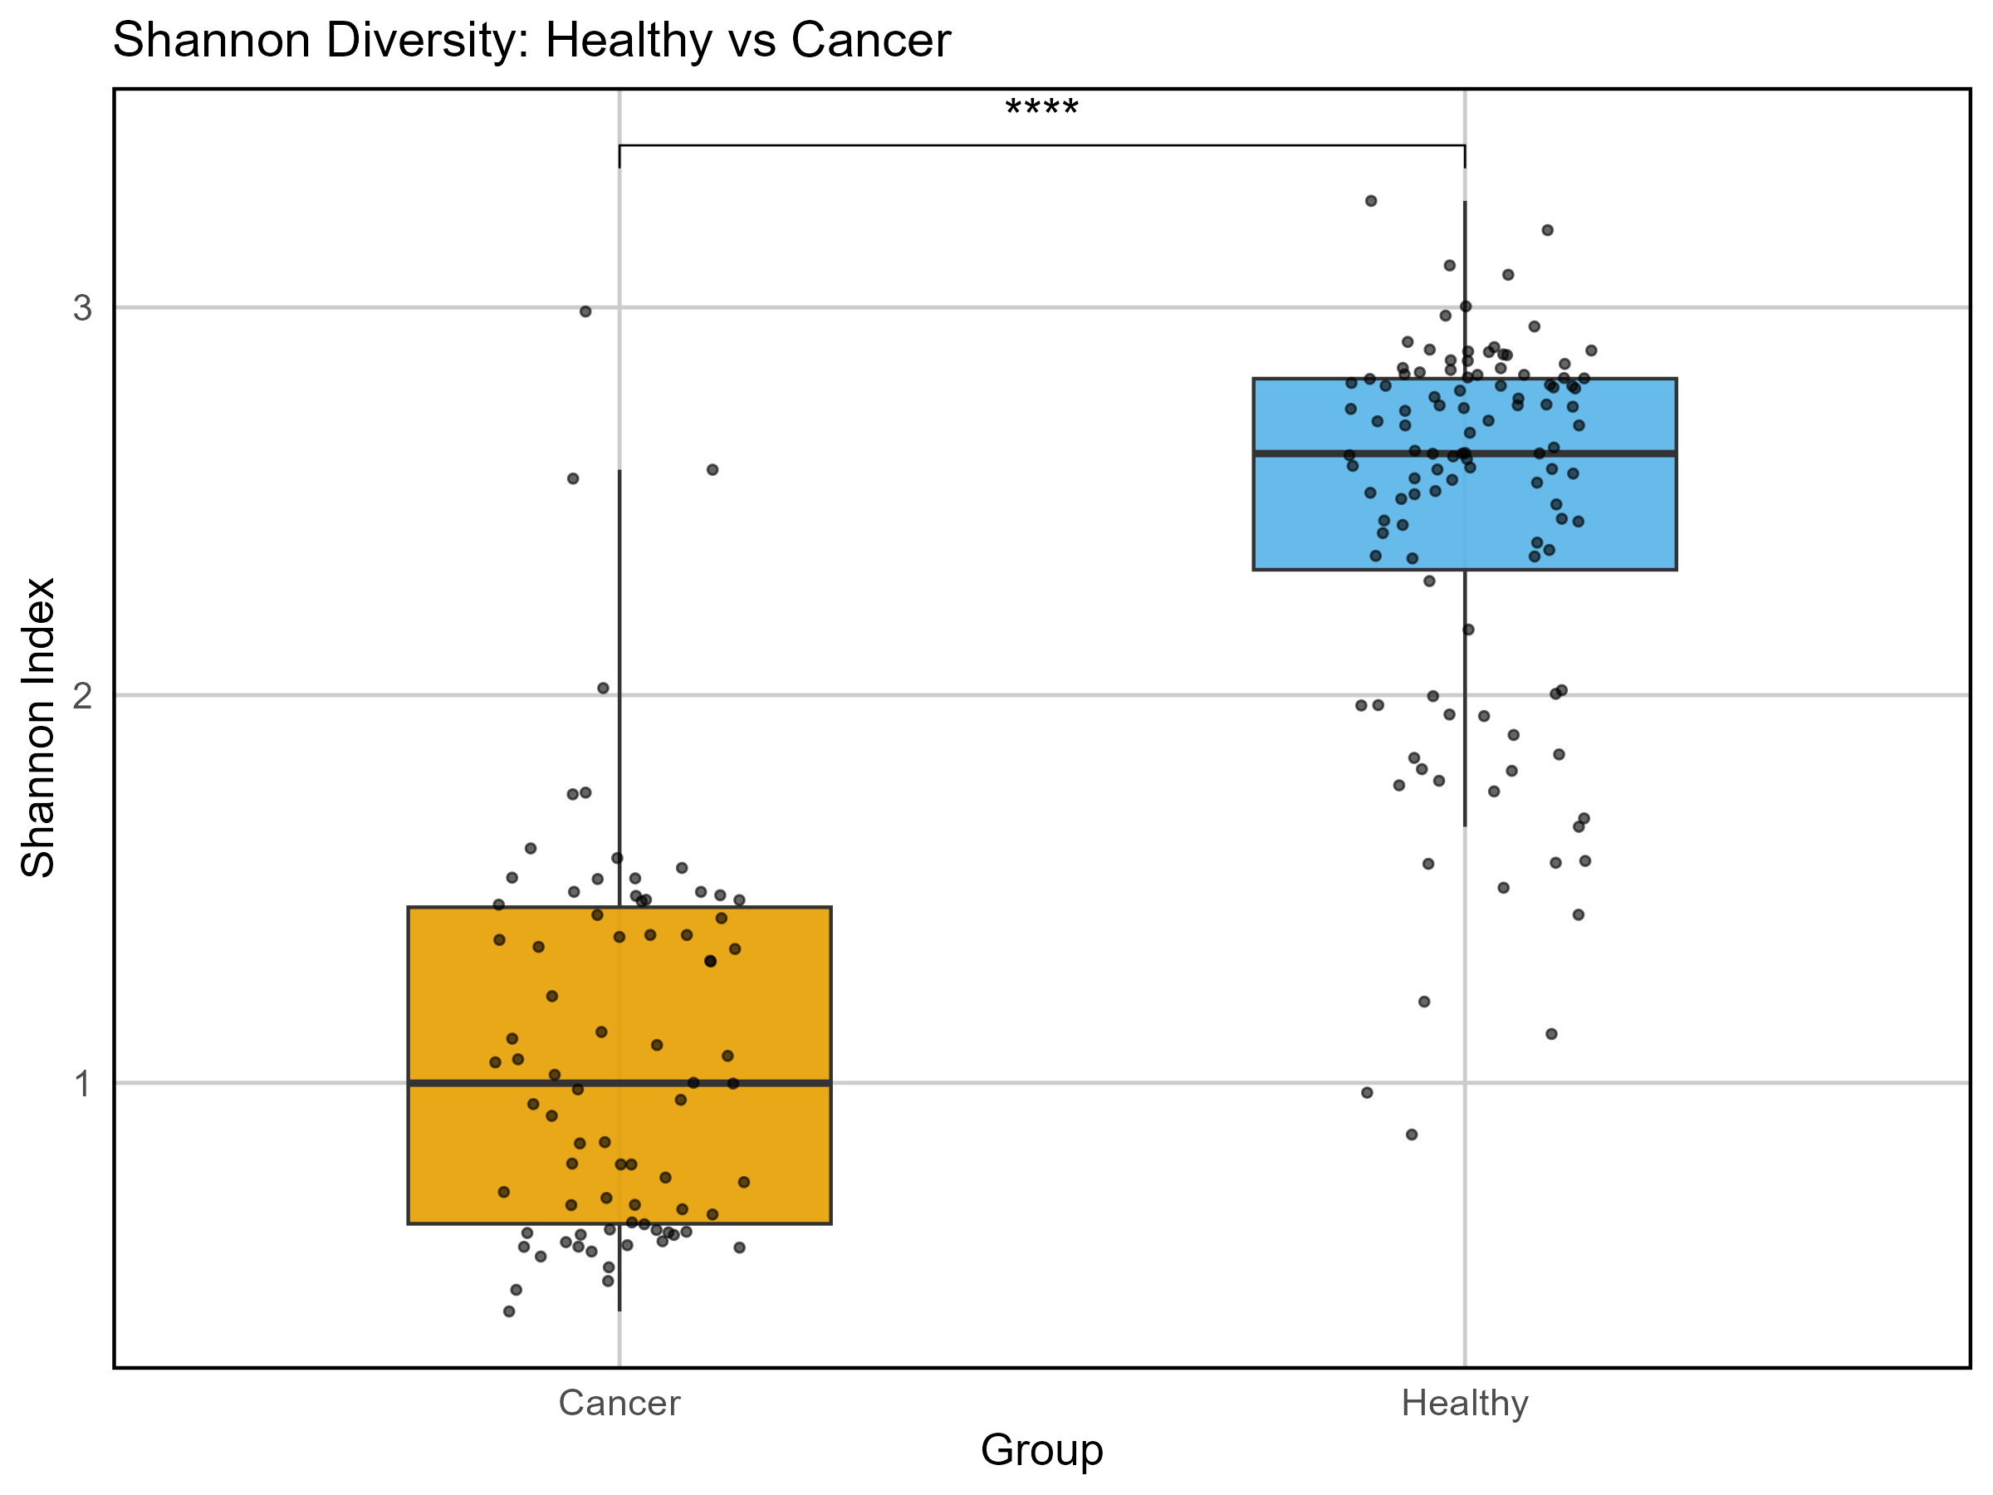
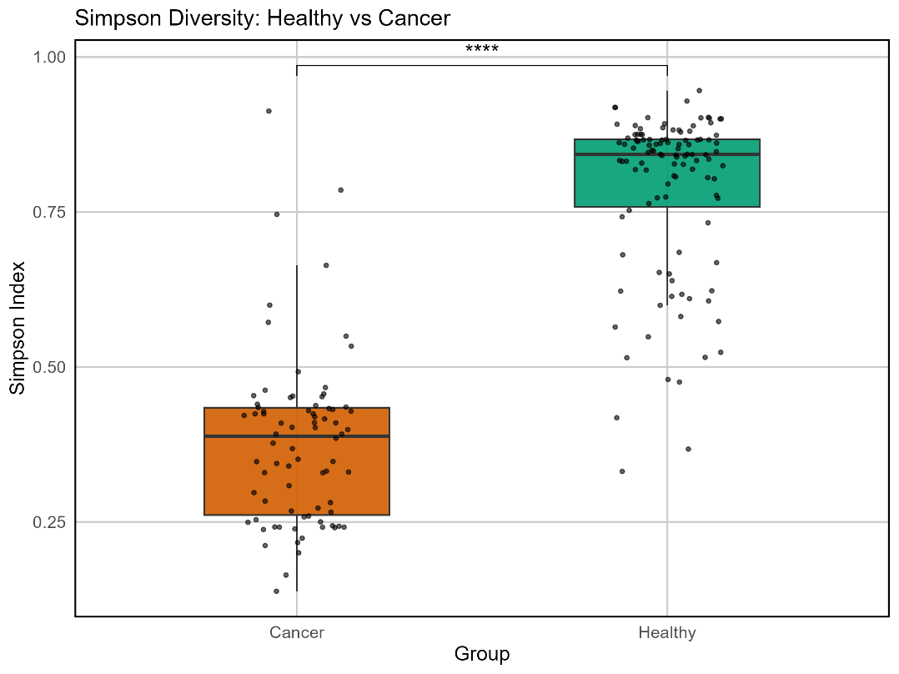
Ecological properties of the Gut microbiome in Healthy and Cancer patients
A
B
Fig. 2: Alpha diversity of gut microbiome for healthy and cancer subjects. A) Shannon diversity index. B) Simpson diversity index.

Slide 10
Ecological properties of the Gut microbiome in Healthy and Cancer patients (β-diversity)
#LOAD NECESSARY PACKAGES
library(readxl)
library(vegan)
library(ggplot2)
library(dplyr)
hh_df_sp<-as.data.frame(hh_species_t)
pC_df_sp<-as.data.frame(pC_species_t)
hh_df_sp$Group<-"Healthy"
view(hh_df_sp)
view(pC_diversity_df)
pC_df_sp$Group<-"Cancer"
#Combine and Clean Data
#First, since the species are different in the different datset, (Force matching is used)
#1: Get the union of all species names (columns)
all_species_beta<-union(colnames(hh_df_sp), colnames(pC_df_sp))
#Add missing Columns (species) with zeros to cancer data
missing_in_pC <- setdiff(all_species_beta, colnames(pC_df_sp))
pC_df_sp[missing_in_pC] <- 0
#Re-order columns to match correctly
hh_df_sp <- hh_df_sp[, all_species_beta]
pC_df_sp <- pC_df_sp[, all_species_beta]
# Fill missing species with zeros (not yet reordered)
missing_in_hh <- setdiff(all_species_beta, colnames(hh_df_sp))
missing_in_pc <- setdiff(all_species_beta, colnames(pC_df_sp))
hh_df_sp[missing_in_hh] <- 0
pC_df_sp[missing_in_pc] <- 0
#Order to Match
hh_df_sp <- hh_df_sp[, all_species_beta]
pC_df_sp <- pC_df_sp[, all_species_beta]
view(hh_df_sp)
#Group
pC_df_sp$Group<-"Cancer"
hh_df_sp$Group<-"Healthy"
#Combine
combined_betadiv_df <- rbind(hh_df_sp, pC_df_sp)
view(combined_betadiv_df)
hh_df_sp$Group <- "Healthy"
pC_df_sp$Group <- "Cancer"
view(hh_df_sp)
#After combining
group_labels <- combined_betadiv_df$Group
combined_betadiv_df$Group <- NULL # remove Group column before calculating distances
view(group_labels)
#Calculate Bray-Cutis distance
# Make sure group labels are stored
group_labels <- c(rep("Healthy", nrow(hh_df_sp)), rep("Cancer", nrow(pC_df_sp)))
# Combine numeric species tables (already fixed earlier)
combined_betadiv_df <- rbind(hh_df_sp, pC_df_sp)
# Calculate Bray-Curtis distance matrix
bray_dist <- vegdist(combined_betadiv_df, method = "bray")
#Check data frame:
str(combined_betadiv_df)
#STore Groups
group_labels <- combined_betadiv_df$Group

Slide 11
Ecological properties of the Gut microbiome in Healthy and Cancer patients (β-diversity)
#Remove group columns before computing distances
# Keep only numeric species data
combined_numeric_df <- combined_betadiv_df[, sapply(combined_betadiv_df, is.numeric)]
#Compute Bryacutis
library(vegan)
bray_dist <- vegdist(combined_numeric_df, method = "bray")
# Run PCoA (Principal Coordinates Analysis)
pcoa_result <- cmdscale(bray_dist, eig = TRUE, k = 2)
# Create a data frame for plotting
pcoa_df <- data.frame(
SampleID = rownames(combined_betadiv_df),
Dim1 = pcoa_result$points[, 1],
Dim2 = pcoa_result$points[, 2],
Group = group_labels
)
library(ggplot2)
# Create the plot and assign it to an object
pcoa_plot <- ggplot(pcoa_df, aes(x = Dim1, y = Dim2, color = Group)) +
geom_point(size = 3, alpha = 0.8) +
stat_ellipse(level = 0.95, linetype = "dashed", size = 1) + # 95% CI ellipse
theme_minimal(base_size = 12) +
theme(
panel.border = element_rect(color = "black", fill = NA, size = 1),
panel.grid.major = element_line(color = "grey85"),
panel.grid.minor = element_blank(),
axis.text = element_text(size = 10),
axis.title = element_text(size = 12),
legend.position = "right"
) +
labs(
title = "PCoA - Bray-Curtis Beta Diversity", x = "PCoA 1",
y = "PCoA 2" ) +
scale_color_manual(values = c("Healthy" = "#56B4E9", "Cancer" = "#E69F00"))
# Print the plot
print(pcoa_plot)
ggsave("PCoA_BrayCurtis_BetaDiversity.png", plot = pcoa_plot, width = 8, height = 6, dpi = 300)

Slide 12
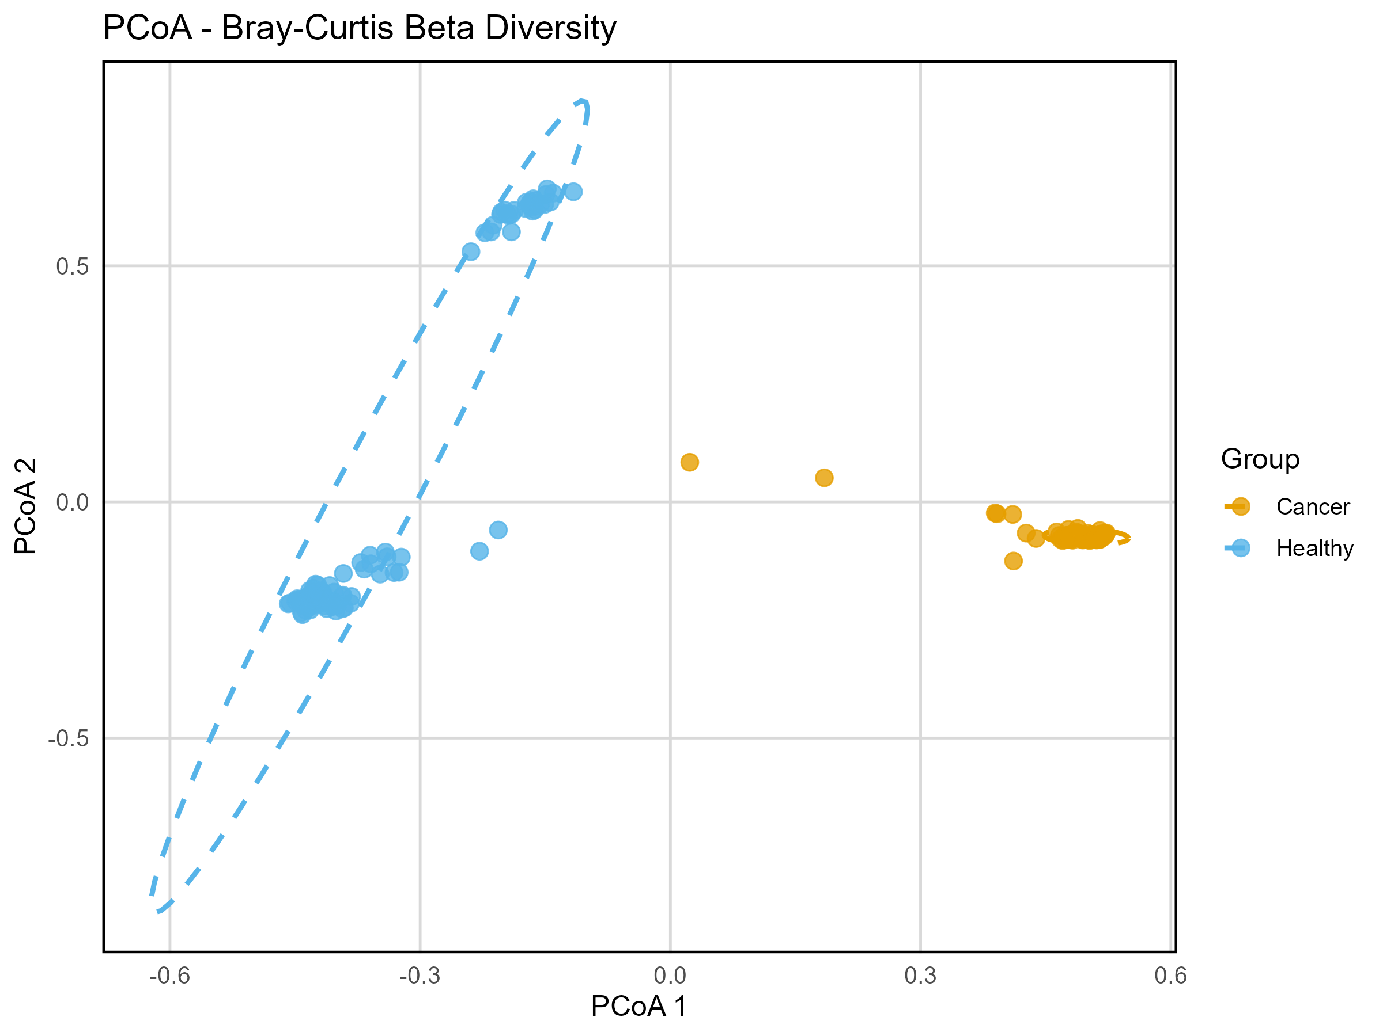
Ecological properties of the Gut microbiome in Healthy and Cancer patients (β-diversity)
Fig. 3: β-diversity of gut microbiome for healthy and cancer subjects.

Slide 13
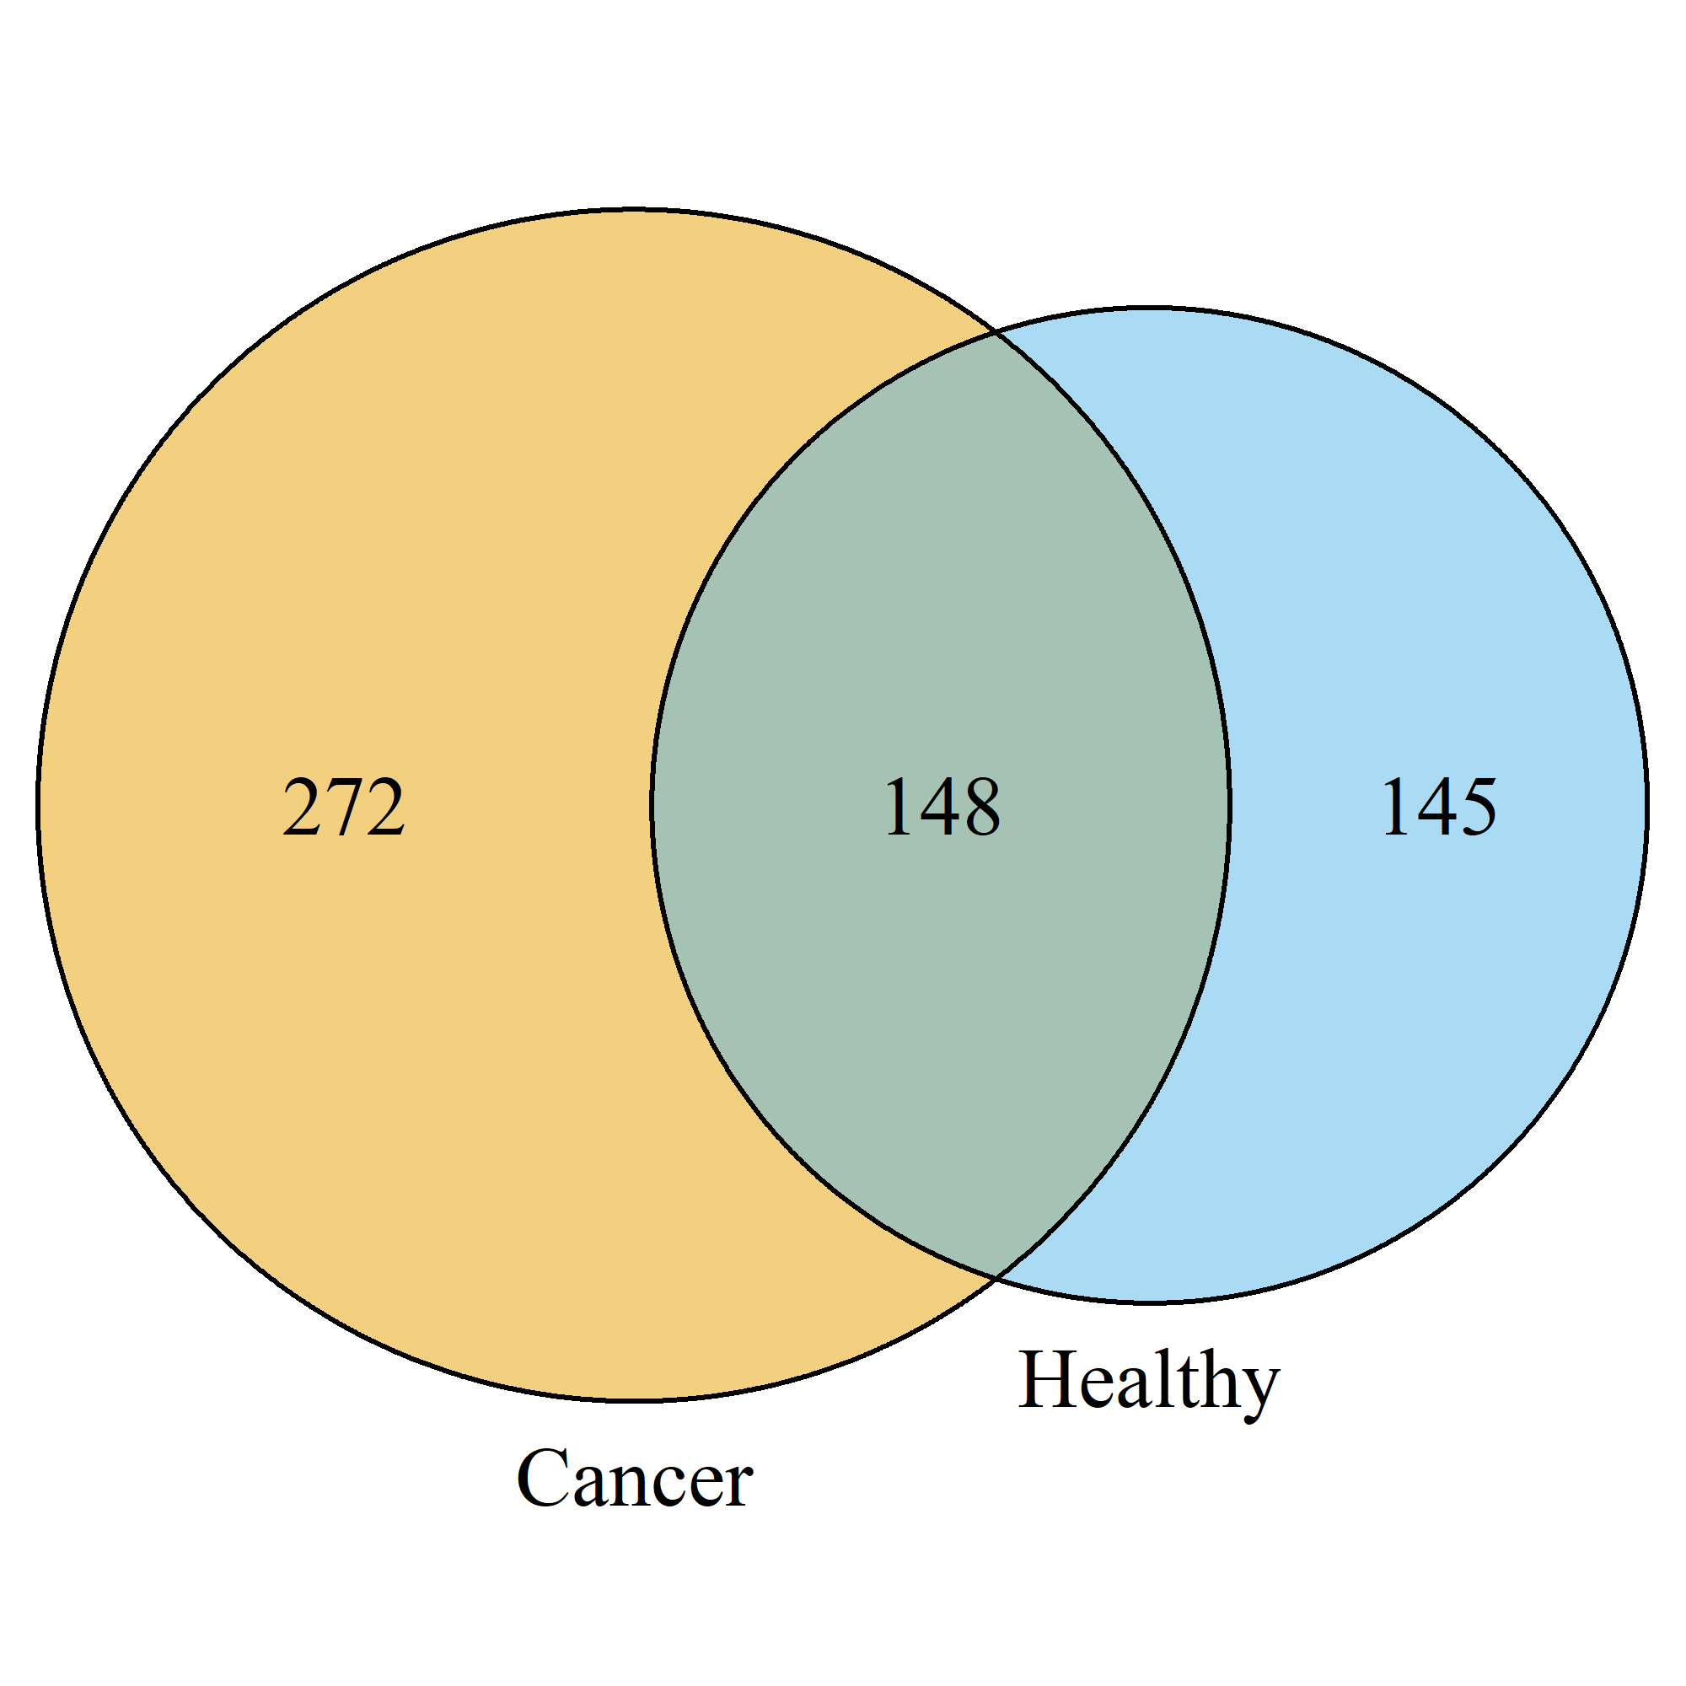
Comparative Taxonomic Analysis of Gut Microbiome in healthy VS Cancer subjects
Codes:
library(VennDiagram)
# Step 1: Identify numeric columns only
hh_numeric_cols <- sapply(h_t_clean, is.numeric)
pc_numeric_cols <- sapply(p_t_clean, is.numeric)
# Step 2: Get species (columns) with non-zero abundance
hh_species <- colnames(h_t_clean)[hh_numeric_cols][colSums(h_t_clean[, hh_numeric_cols]) > 0]
pc_species <- colnames(p_t_clean)[pc_numeric_cols][colSums(p_t_clean[, pc_numeric_cols]) > 0]
# Step 3: Generate and save Venn diagram
venn.plot <- venn.diagram(
x = list(Healthy = hh_species, Cancer = pc_species),
category.names = c("Healthy", "Cancer"),
filename = "venn_species_overlap.png", # Saves to current working directory
output = TRUE,
imagetype = "png",
height = 2000,
width = 2000,
resolution = 300,
col = "black",
fill = c("#56B4E9", "#E69F00"),
alpha = 0.5,
cex = 2,
cat.cex = 2,
cat.pos = 0
)
Fig. 4: Differential abundance of microbial species in health and disease state
.
Notes:
PART B Taxanomic COmparison
#Q: Which Bacteria are more Abundant in Healthy VS Cancer?
#Option A: Wilcoxon test (for small datasets

Slide 14
Comparative Taxonomic Analysis of Gut Microbiome in healthy VS Cancer subjects
Codes:
library(pheatmap)
# Choose top 20 species based on lowest adjusted p-values
top_heatmap_species <- results_df$Species[order(results_df$p_adj)][1:20]
# Prepare abundance matrix for heatmap (samples as rows, species as columns)
heatmap_data <- combined_data[, top_heatmap_species]
rownames(heatmap_data) <- paste0(combined_data$Group, "_", seq_len(nrow(combined_data)))
# Group annotation (used for coloring rows by Healthy or Cancer)
annotation <- data.frame(Group = combined_data$Group)
rownames(annotation) <- rownames(heatmap_data)
# Plot heatmap with species names shown (they are columns)
pheatmap(
t(heatmap_data), # Transpose so species are on y-axis
annotation_col = annotation, # Now columns are samples
scale = "row", # Normalize species abundance per row
show_rownames = TRUE, # Show species names
show_colnames = FALSE, # Hide sample names if too many
fontsize_row = 8, # Adjust if species names are too long
clustering_distance_rows = "euclidean",
clustering_distance_cols = "euclidean",
color = colorRampPalette(c("navy", "white", "firebrick3"))(100),
main = "Heatmap of Top 20 Differential Species")
.
Notes:
Top 20 differentially abundant species in the subjects

Slide 15
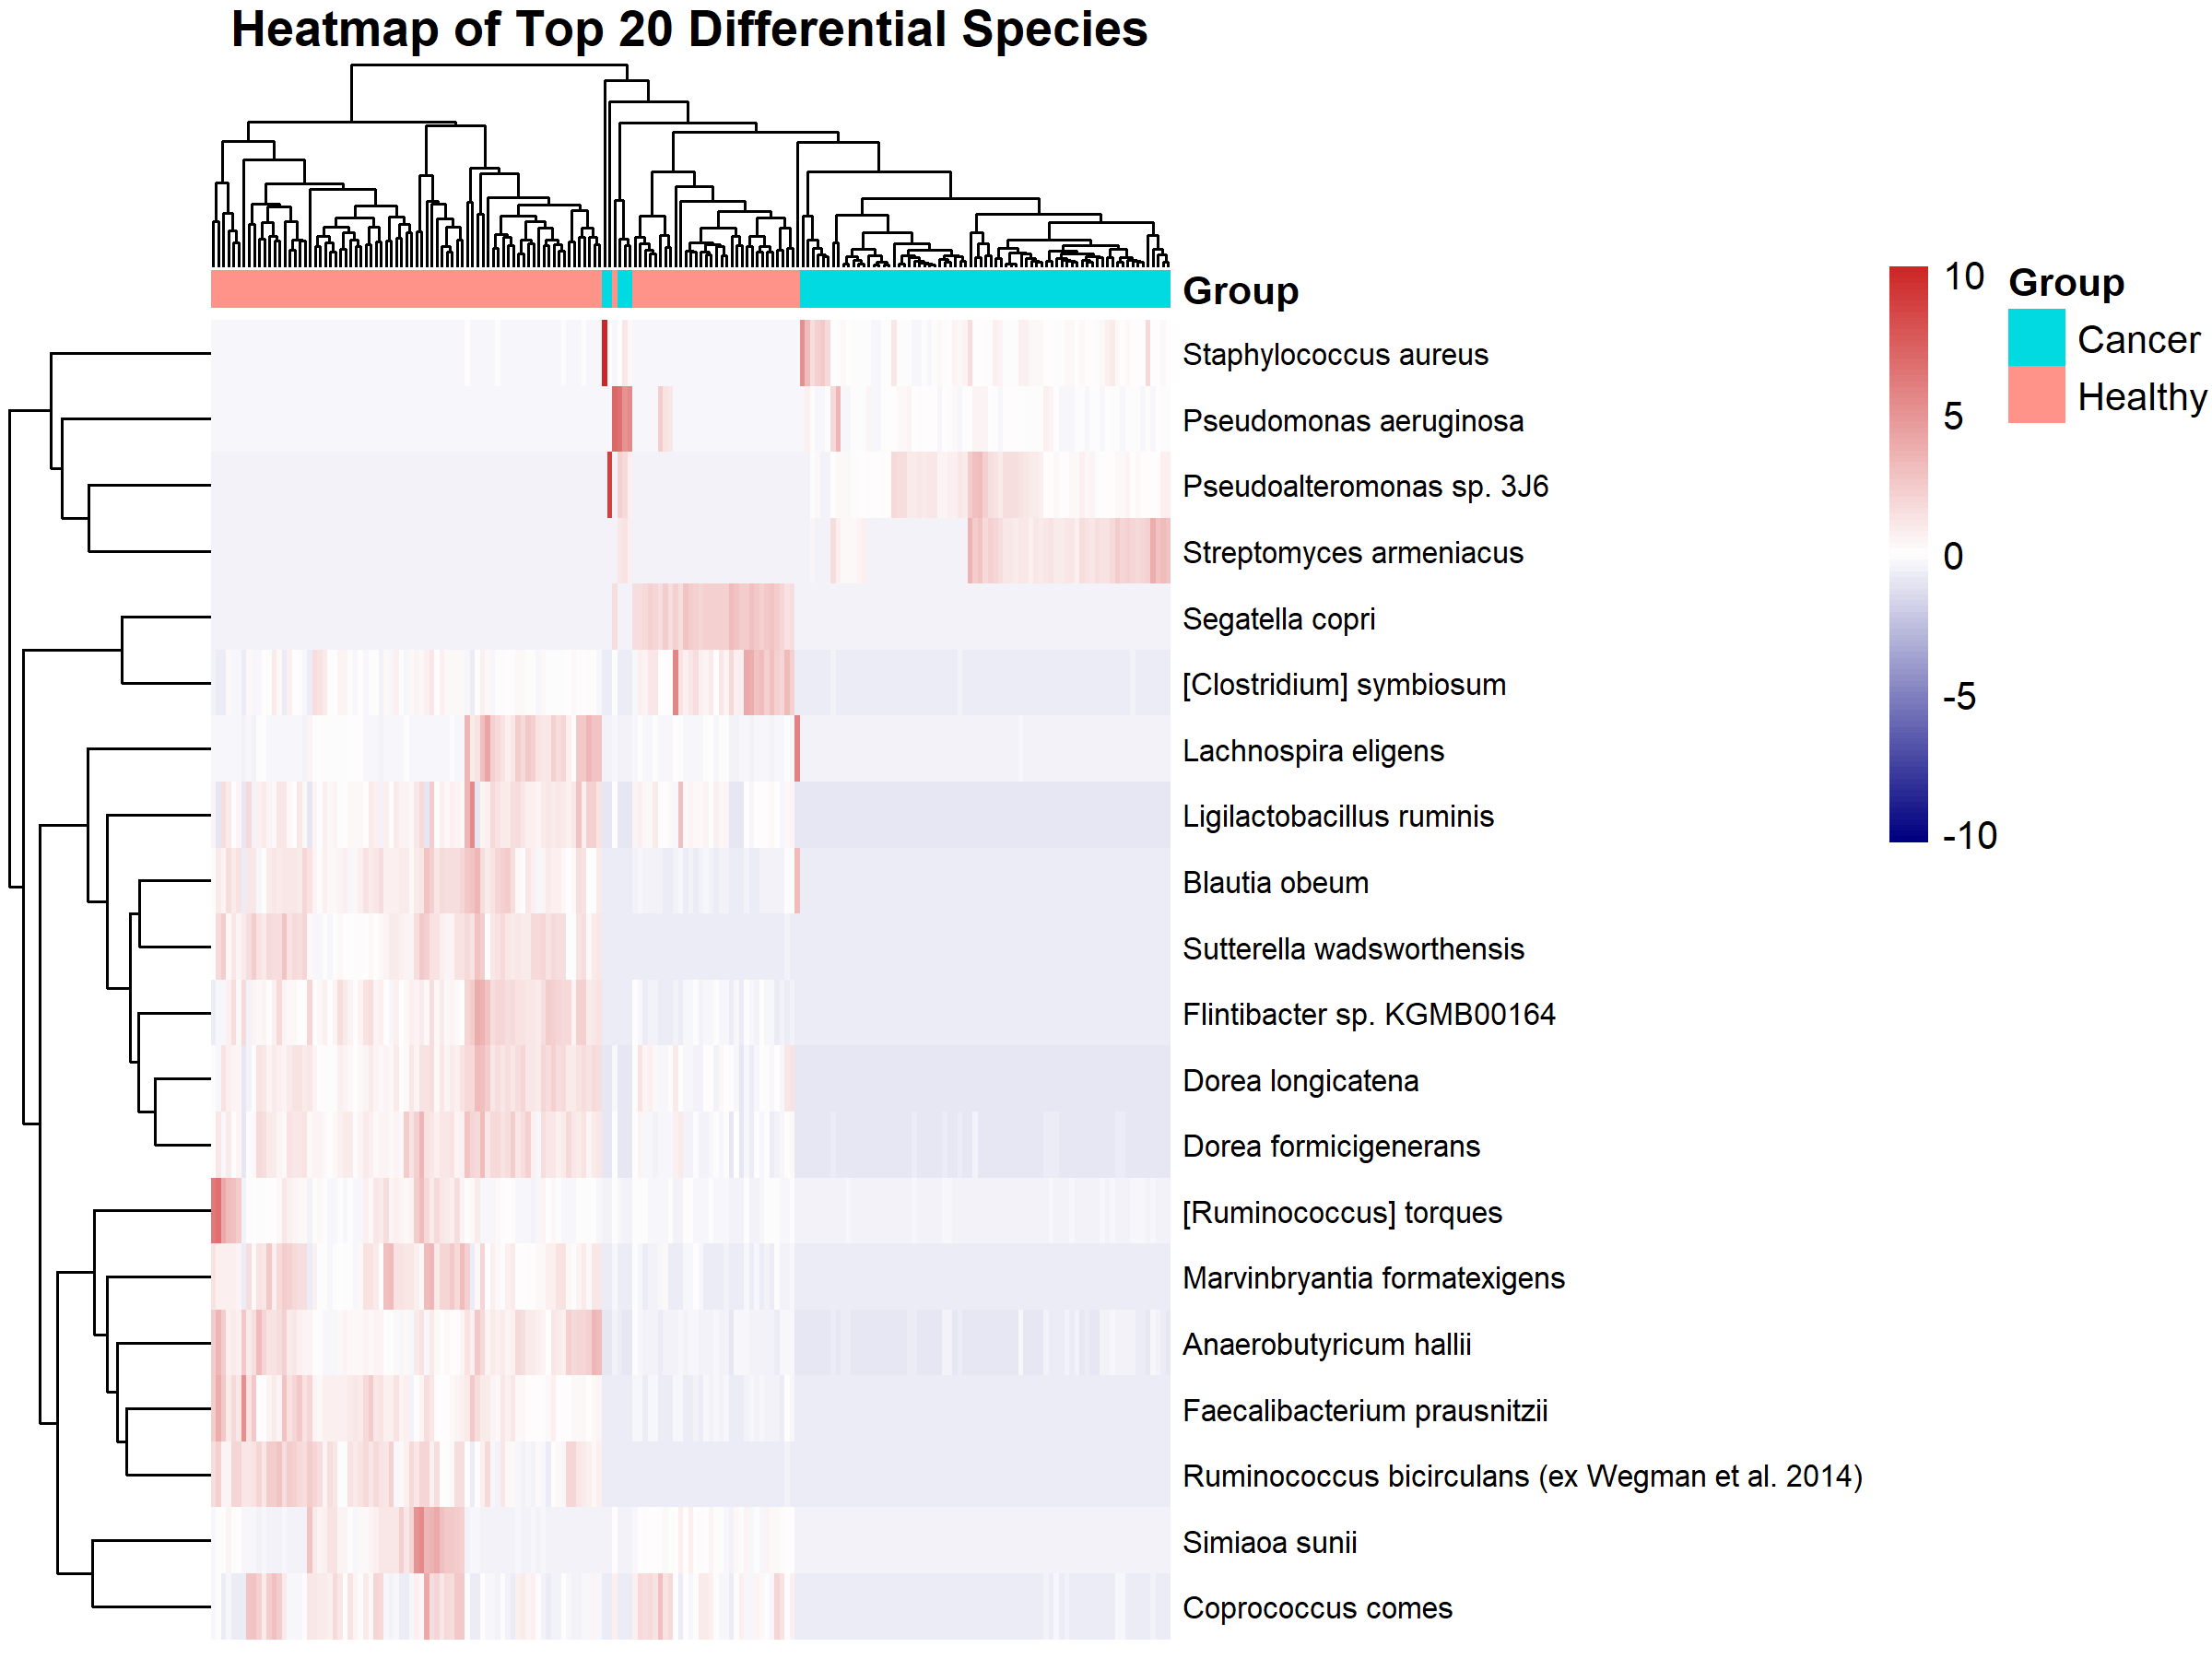
Comparative Taxonomic Analysis of Gut Microbiome in healthy VS Cancer subjects
Fig. 5: Top 20 differentially abundant species
.
Notes:
Top 20 differentially abundant species in the subjects

Slide 16
Comparative Taxonomic Analysis of Gut Microbiome in healthy VS Cancer subjects
#Top 30 Gut microbiome
# Load libraries
library(dplyr)
library(ggplot2)
# Step 1: Prepare the abundance matrix and group info
group_factor <- combined_data$Group
# ✅ Remove non-numeric columns for abundance matrix
abundance_matrix <- combined_data[, sapply(combined_data, is.numeric)]
# Step 2: Run indicator species analysis
library(indicspecies)
library(vegan)
abundance_matrix <- combined_data[, -ncol(combined_data)] # assuming last column is Group
ind_result <- multipatt(abundance_matrix, group_factor, control = how(nperm = 999))
group_factor <- combined_data$Group
# Step 3: Extract significant species
ind_df <- as.data.frame(ind_result$sign)
ind_df$Species <- rownames(ind_df)
# Step 4: Identify top 30 species per group based on indicator statistic
top_healthy <- ind_df %>%
filter(s.Healthy == 1) %>%
slice_max(stat, n = 30)
top_cancer <- ind_df %>%
filter(s.Cancer == 1) %>%
slice_max(stat, n = 30)
# Step 5: Get species names
top_healthy_species <- top_healthy$Species
top_cancer_species <- top_cancer$Species
# Step 6: Subset original data by group
healthy_data <- combined_data %>% filter(Group == "Healthy")
cancer_data <- combined_data %>% filter(Group == "Cancer")
# Step 7: Extract abundance values for top species
healthy_abundances <- healthy_data[, top_healthy_species]
cancer_abundances <- cancer_data[, top_cancer_species]
# Step 8: Compute mean abundance per species
healthy_means <- colMeans(healthy_abundances, na.rm = TRUE)
cancer_means <- colMeans(cancer_abundances, na.rm = TRUE)
df_healthy <- data.frame(Species = names(healthy_means), Abundance = healthy_means, Group = "Healthy")
df_cancer <- data.frame(Species = names(cancer_means), Abundance = cancer_means, Group = "Cancer")
# Step 9: Plot bar graphs
p_healthy <- ggplot(df_healthy, aes(x = reorder(Species, Abundance), y = Abundance)) +
geom_bar(stat = "identity", fill = "#1b9e77") +
coord_flip() +
labs(title = "Top 30 Abundant Species in Healthy Group", x = "Species", y = "Mean Abundance") +
theme_minimal(base_size = 12)
p_cancer <- ggplot(df_cancer, aes(x = reorder(Species, Abundance), y = Abundance)) +
geom_bar(stat = "identity", fill = "#d95f02") +
coord_flip() +
labs(title = "Top 30 Abundant Species in Cancer Group", x = "Species", y = "Mean Abundance") +
theme_minimal(base_size = 12)
# Step 10: Display plots
print(p_healthy)
print(p_cancer)
# Save to file
ggsave("top30_abundant_species_healthy.png", p_healthy, width = 10, height = 8, dpi = 300)
ggsave("top30_abundant_species_cancer.png", p_cancer, width = 10, height = 8, dpi = 300)
.
Notes:
Top 20 differentially abundant species in the subjects

Slide 17
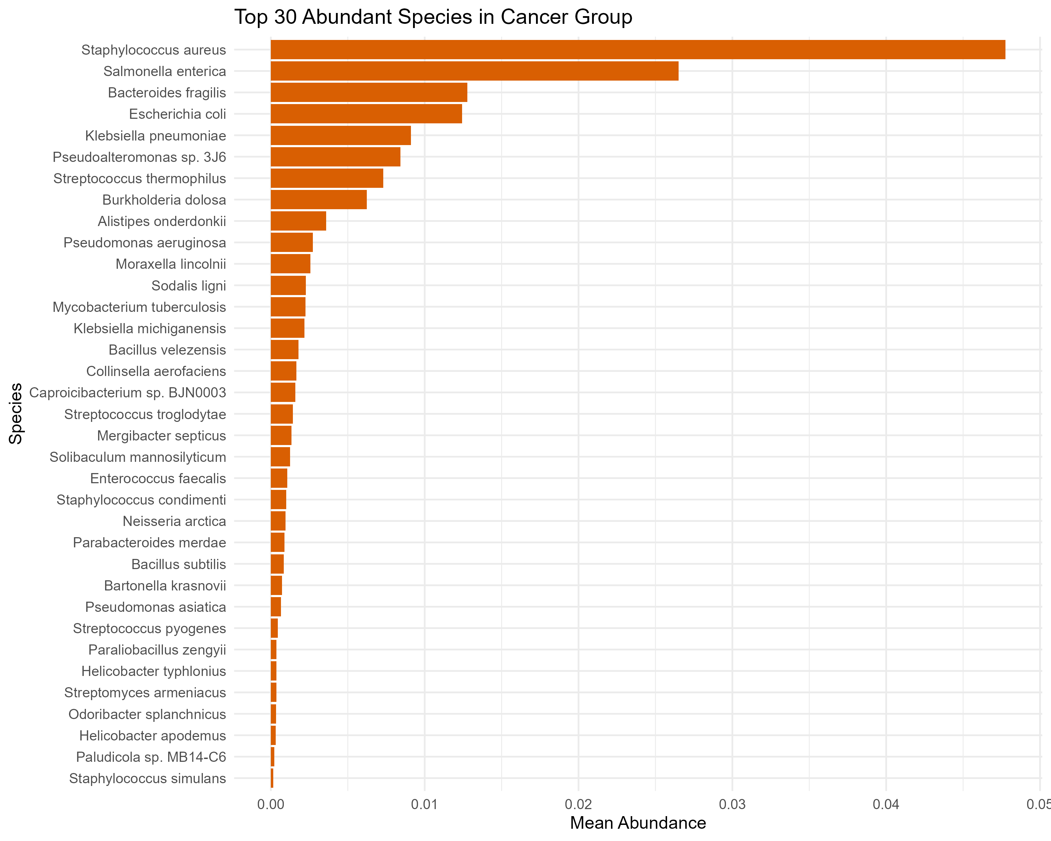
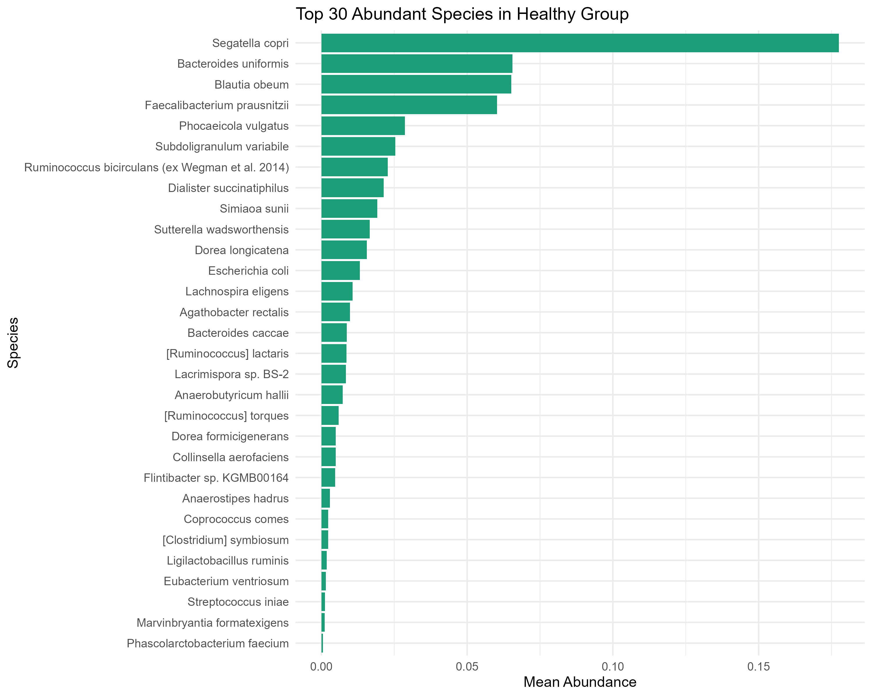
Comparative Taxonomic Analysis of Gut Microbiome in healthy VS Cancer subjects
Fig. 6 Differential species abundance of gut microbiomes in Healthy and cancer subjects
.
Notes:
Top 30 differentially abundant species in the subjects

Slide 18
Conclusion
The data suggests a difference in the richness and diversity of the gut microbiome in cancer patients versus healthy individuals.
There is an increase in proteobacteria in cancer patients compared to healthy individuals, suggesting gut dysbiosis.
Strikingly, unique taxa are common in the cancer gut microbiome, including Fusobacterium sp., Staphylococcus sp. Fusobacterium is known to be highly associated with colorectal cancer.

Slide 19

Acknowledgment
Mahmud Shojiv, Noakhali

Slide 20
References
1. "Some of the data analysis code and figure generation were assisted by OpenAI's ChatGPT (version GPT-4, 2025), an AI language model.“
2. Lloyd-Price, J. et al. Multi-omics of the gut microbial ecosystem in inflammatory bowel diseases. Nature 569, 655–662 (2019).
3. Yao, T. et al. Differences in fine arabinoxylan structures govern microbial selection and competition among human gut microbiota. Carbohydr Polym 316, (2023).
4. Hadley Wickham, Mine Cetinkaya-Rundel, and Garret Grolemund, R for Data Science (2e)https://r4ds.hadley.nz/preface-2e.html

